Slide 1
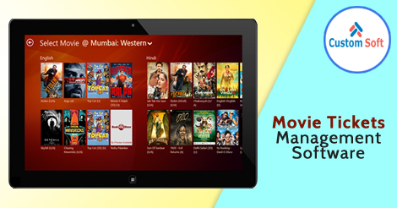
Movie Ticket Management Software by CustomSoft

Slide 2
Methodology of Movie Ticket Management Software
Movie Ticket booking Software is associated with all the theatres in the city. User need to register on the Software to get features benefit. After registration user can see names of all the theatres with movie available.
User can also see the ticket pricing as per the theatre. User needs to select theatre and after theatre selection user can see seats available in that respective theatre.
User then make payment via debit or credit card and book

Slide 3
Features of Movie Ticket Management Software
Price listing as per the theatre
Discounts and offers
Refund in case of ticket cancellation
Review and feedback
User friendly with attractive UI

Slide 4
Movie Ticket Management Software

Slide 5
Movie Ticket Management Software by CustomSoft
Advantages
Time saving
User friendly
Compatible with all devices
User can get desired seats
Multiple options available on one click

Slide 6
About CustomSoft
CustomSoft is custom offshore software outsourcing company with expertise in outsourced product development & enterprise application development services. CustomSoft is providing high-quality, custom software development and many business related outsourcing services to industries and enterprises around world.
CustomSoft ensure effective outsourcing partnerships with our globally located clients so as to fasten time to market, reduce the actual processing cost and automating their tasks, which helps them to devote remaining time for the core business activities.

Slide 7
Contact CustomSoft
To Contact CustomSoft:
http://www.custom-soft.com/contact_us.html
Visit: http://www.custom-soft.com
Email: info@custom-soft.com
To know more about CustomSoft:
http://www.custom-soft.com/about_us.html

Slide 8
Thank You

